Slide 1
Solar plant setup for 10 houses

Slide 2
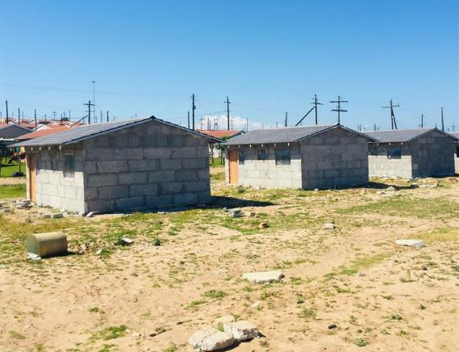
Problem statement
We have a setup of 10 houses which need solar panels installed
Would it be better to have each house with its own solar panel?
Considerations: each house needs its own inverter, might not manage the load
Or have a small solar farm which feeds all the houses?
No load problems per house, if one needs more than
Less inverters needed
If solar farm fails, all houses affected
Want to show that a solar farm will be a more beneficial setup due to the higher capacity evening out the load per house even if they exceed a single solar panel capacity

Slide 3


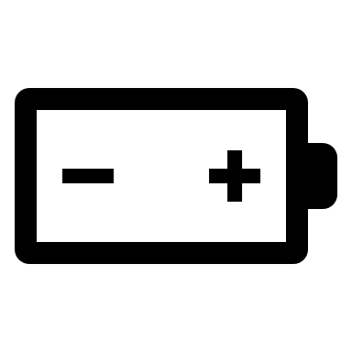

Setup 1: Solar panel per house
PV profile
[PV Profile]
- profile (map)
PV [Solar Panel] (unit)
- Is_active
- Existing
Unit_node_profile
- profile_method: upper_limit
House electricity
[Electricity Supply]
(connection)
- Is_active
- Existing
- Efficiency
Unit_outputNode
Connection_node_node
DC bus [DC Bus] (node)
- Is_active
- Has_balance
- penalty_up and down
Charger/discharger
[Battery Charger]
(connection)
- Is_active
- Existing
- Efficiency
- transfer_method
Unit_inputNode
Battery
[Battery]
(node)
- Is_active
- Has_balance
- Has_storage
- Existing
- Storage_start_end_method
- Storage_state_start
- Storage_state_end
- penalty_down
- penalty_up
Inverter
[Inverter] (unit)
- Is_active
- Existing
- Efficiency
Grid [Grid] (node)
- Is_active
Grid supply
[Electricity] (commodity)
- price
Connection_node_node
House / AC bus [House] (node)
- Is_active
- Has_balance
- Inflow
- Penalty_up and penalty_down
+ If demand response:
- Has_storage
- Existing (constant/time varying)
- Storage_state_Start/end method
Commodity_node

Slide 4


Setup 2: Solar grid for all houses
Charger/discharger
[Battery Charger]
(connection)
- Is_active
- Existing
- Efficiency
- transfer_method
PV profile
[PV Profile]
- profile (map)
PV units aggregated
[Solar Panel] (unit)
- Is_active
- Existing
Unit_outputNode
Unit_node_profile
- profile_method: upper_limit
Batteries aggregated
- possibility to simulate partial unavailability (to model reliability)
[Battery]
(node)
- Is_active
- Has_balance
- Has_storage
- Existing
- Storage_start_end_method
- Storage_state_start
- Storage_state_end
- penalty_down
- penalty_up
Connection_node_node
DC buses aggregated [DC Bus] (node)
- Is_active
- Has_balance
- penalty_up and down
Commodity_node
Grid [Grid] (node)
- Is_active
Grid supply
[Electricity] (commodity)
- price
Inverters aggregated
- possibility to simulate partial unavailability (to model reliability)
[Inverter] (unit)
- Is_active
- Existing
- Efficiency
Unit_inputNode
Connection_node_node
AC buses aggregated
[AC Bus] (node)
- Is_active
- Has_balance
- penalty_up and down
House / AC bus
[House 1, House 2 etc.] (node)
- Is_active
- Has_balance
- Inflow
- Penalty_up and penalty_down
Electricity Supply
[Grid to AC Bus Supply]
(connection)
- Is_active
- Existing
- Efficiency
House x Supply per house
[House x Supply]
(connection)
- Is_active
- Existing
- Efficiency
Connection_node_node per house
+ If demand response:
- Has_storage
- Existing (constant/time varying)
- Storage_state_Start/end method
Each house as own node with own load profile

Slide 5
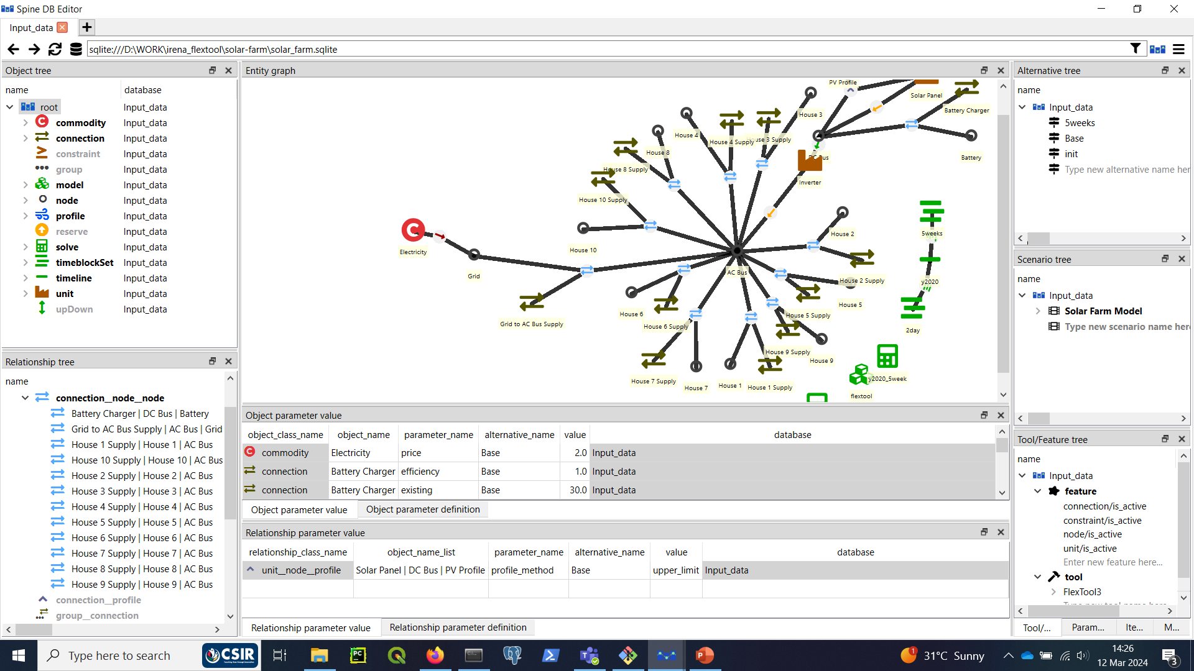

Slide 6
Setup 2: (deprecated) solar grid per all houses
PV units aggregated
DC buses aggregated
Batteries aggregated
- possibility to simulate partial unavailability (to model reliability)
Inverters aggregated
- possibility to simulate partial unavailability (to model reliability)
Grid connection
AC buses aggregated
Each house as own node with own load profile

Slide 7
Thank you

